Slide 1
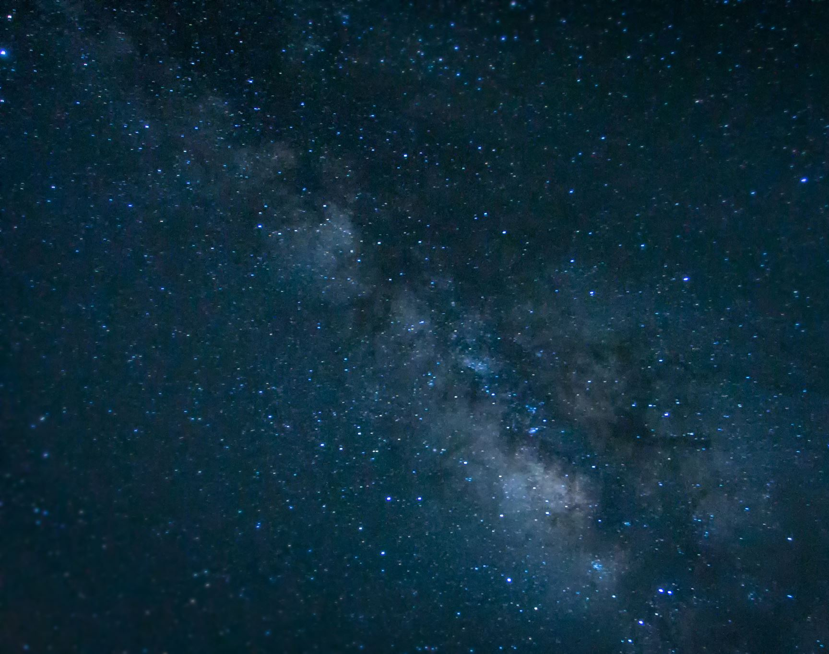
Modelling Supermassive Primordial Stars in MESA
Presentation by Thomas McRobie
Acknowledgements to:
Daniel Whalen
Nicholas Herrington
Notes:
This project is on Modelling Supermassive Primordial Stars in MESA, based on the Surace, Whalen 2019 paper on the detection of Pop II. Blue Supermassive Stars.

Slide 2
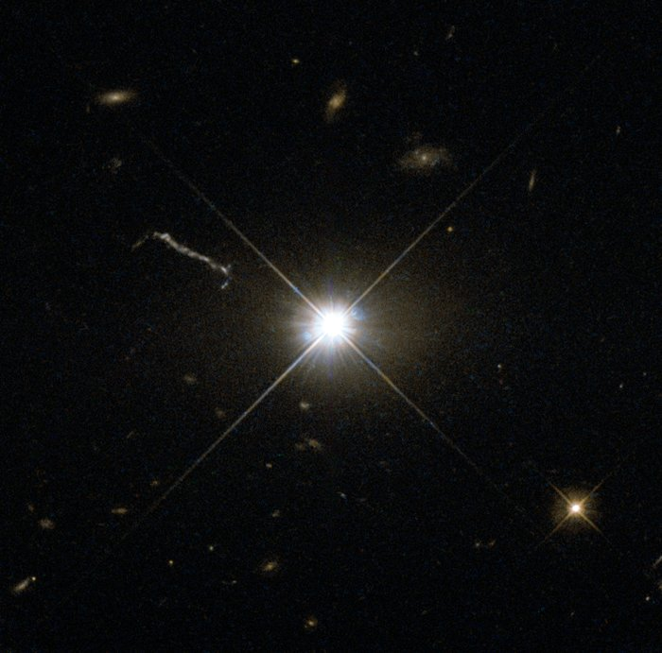
High Redshift Quasars?
300+ Quasars found z ≥ 6 (830 Myrs after The Big Bang; Mortlock 2009)
7 Quasars found z ≥ 7 (690 Myrs after The Big Bang; Mortlock 2011)
How did they form in such a short amount of time?
Quasar 3C 273 caught by Wide Field and Planetary Camera 2
https://www.spacetelescope.org/images/potw1346a/
Notes:
The drive of this project is that within the last decade there has been over 300 quasars detected at redshift 6 and 7 quasars detected at redshift 7.
The significance of this is that therefore means these quasars existed within the first billion years after the Big Bang. As we know quasars are formed from Massive Black Holes and are extremely bright and powerful Active Galactic Nuclei, which means that they would take billions of years to form due to the fact a star must go through its life cycle to turn into a black hole, and merge with other black holes to be big enough to support an AGN.
TRANSITION
So, how did they form in such a short amount of time?
The image to the right is of Quasar 3C 273 which is of redshift 0.158 and is one of the most luminous quasars known.

Slide 3




Form haloes that are:
Hot
Massive
15 ≤ Z ≤ 20
Atomically Cooling
Gas Collapse at centre of halo ≤ 1 M☉yr ⁻¹ (Latif& Volonteri 2015)
Notes:
The logical model would be that the stars that seed these quasars would be supermassive and given he composition of the Universe at that time is mostly Hydrogen and Helium with trace amounts of Lithium, the stars would have the same composition.
Additionally, we made the assumptions that the halos these stars formed in are hot,
TRANSITION
massive,
TRANSITION
between redshift 15 and 20 – of which the Surace Whalen paper goes into more detail on the detection of these stars,
TRANSITION
And the halo would be atomically cooling allowing for a gas collapse rate of roughly a solar mass per year.

Slide 4
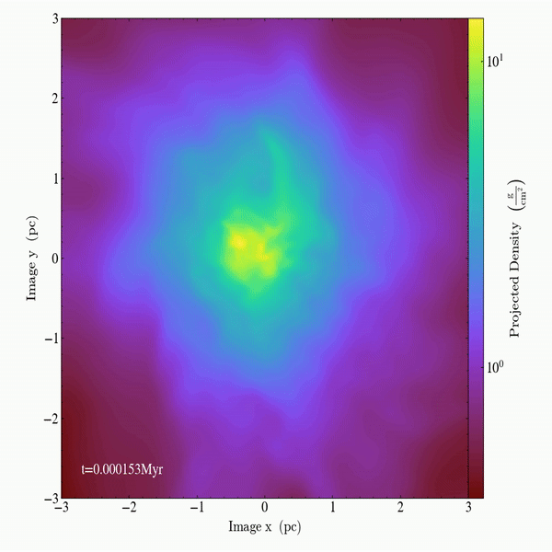
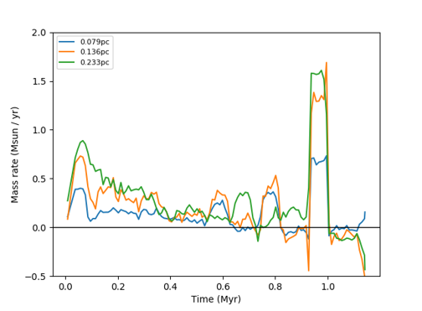
Birth of the First Quasars
Notes:
Here is an animation of a model of a primordial gas cloud collapsing, forming a quasar.
The colourmap shows the projected density of mass and the plot on the right shows the accretion rate over time in solar masses, over three resolution values.
This reinforces the accretion value of 1 M_sun per year as you can see the peaks on the right hand side diagram.

Slide 5




Simulation
and also it’s capability of modelling a stars’ evolution and later collapse.
During this project I used:
Modules for
Experiments in
Stellar
Astrophysics
For its effectiveness in simulating the:
Low metallicity
Rapid Mass Loss/Gain
Notes:
To model these conditions we used MESA due to the nature of what we need it to model, t
TRANSITION
hat being the low metallicity composition and the rapid mass gain.
TRANSITION
Additionally, it is very easy to compute the early sequence of a stars formation, and allow MESA to run through to the red giant phase and star collapse.

Slide 6
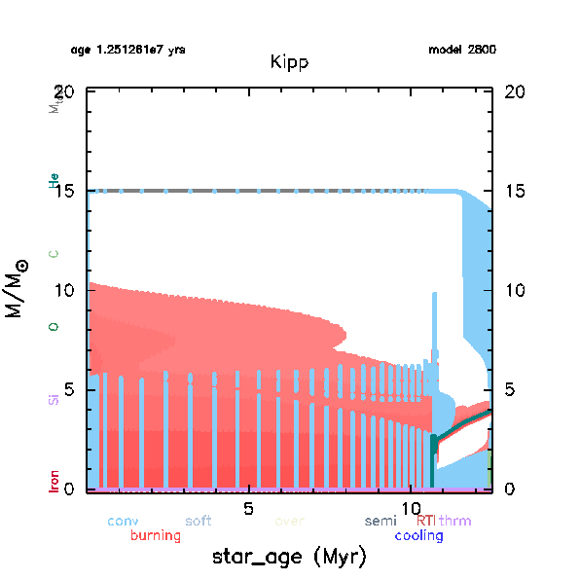
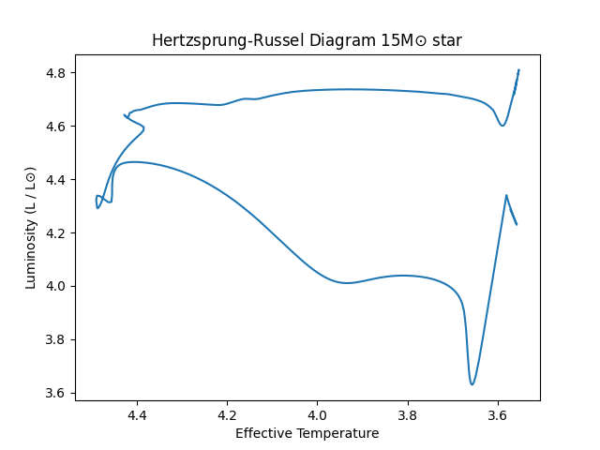
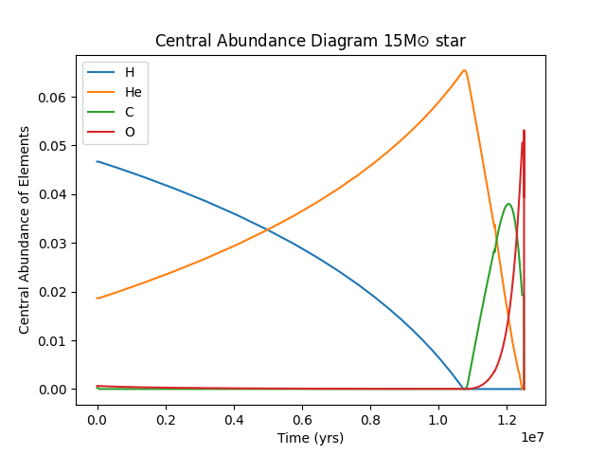
15 M☉
Notes:
Here is the test case that we did to verify that what we were modelling is accurate. We modelled a 15 solar mass star and you can its journey through its main sequence and its post main sequence arching back over in an HR diagram.
TRANSITION
Also a Kippenhahn diagram showing convection and mixing in blue, where there is white there is no mixing, and signifies a radiative zone, and in red it shows burning – or rather where there is high energy production. Also the composition of the core in the bottom of the plot where the darker green is oxygen burning.
TRANISITION
And here is an abundance diagram of the core, and again we see what you would expect from a massive star with the hydrogen burning being overtaken by helium burning over its main sequence and then the heavier elements of Carbon and Oxygen becoming more abundant in the core.

Slide 7
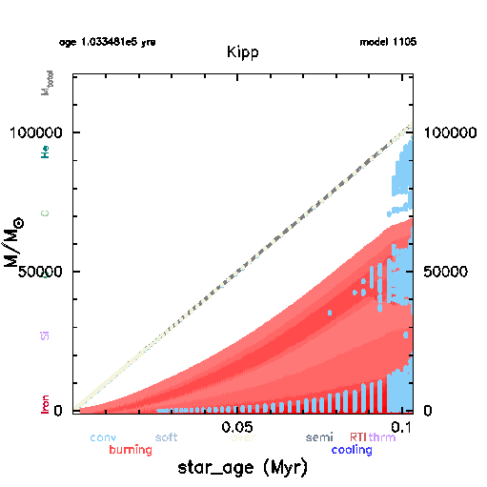
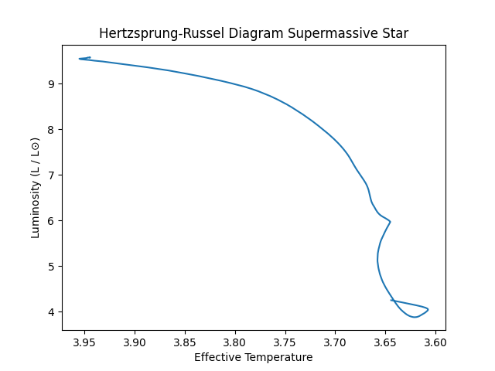
Supermassive Star
Notes:
Here you can see the results we got from MESA modelling a Supermassive Star which reached of the order 100,000 solar masses in the kippenhahn diagram which shows more burning due to the highly-energetic nature of the star, and a larger white , radiative region, as well its exponential growth in mass.
TRANSITION
. In the HR diagram you can see its journey along its main sequence which is not too dissimilar to that of a normal star .
TRANSITION
What we are missing is the arcing post main sequence of the star, which begs the question of why isn’t there one?

Slide 8
The General Relativistic Instability
The Star gets hotter
Produces more Photons
The Star Contracts
Notes:
The conclusion drawn from these plots is that these stars don’t actually explode in a standard supernova as you would expect.
The reason for this is due to this Relativistic instability; A supermassive star core is dense with thermal photons that the net of them actually contribute to the gravity of the star through the stress-energy tensor – which the Chandrasekhar 1964 paper goes into more depth.
It would only contribute of an order of 0.1%
TRANSITION
but that is still enough to promote contraction, and is a compounded effect which explains the exponential nature of its growth.
TRANSITION
As you can see in the diagram this creates a cycle of star contraction, leading to a hotter core, which then means more production of photons, which then leads to more contraction and so on.
This therefore means that supermassive stars will go through this process and reach a critical contraction where it does not have the necessary energy to expand to an equilibrium and the entire core becomes in-falling and form a direct collapse black hole.
This black hole would then continue accreting from the gas halo it resides in and continue to grow to form a quasar.

Slide 9
General Relativistic Instability
Chandrasekhar S., 1964, ApJ, 140, 417
Detection of Pop II. Supermassive Primordial Stars
Surace M., Zackrisson E., Whalen D. J., Hartwig T., Glover S., Woods T. E.,Heger A., Glover S., 2019, Monthly Notices of the Royal AstronomicalSociety, 488, 3995
Redshift z ≥ 6 Quasars
Mortlock D., et al., 2009, Astronomy & Astrophysics, 505, 97
Redshift z ≥ 7 Quasars
Mortlock D. J., et al., 2011, Nature, 474, 616
Solar Mass accretion of ≈1M ☉yr ¹
Latif M., Volonteri M., 2015, Monthly Notices of the Royal AstronomicalSociety, 452, 1026
Notes:
This model fits the criteria of taking a shorter amount of time to form quasars, and serves as an explanation for why we see them at high redshifts.
Here are the references.
For next steps, I would model more stars of different masses and conditions with a variable accretion rates that is more representative of what the data shows on slide 4.
Thank you.

